Slide 1
Notes:
Hi, we are going to present a digital marketing campaign from a project management standpoint

Slide 2
Group #12 : Team
Amit Sharma
0794488
Group Leader
DB Pipelines
Leadership
Harshil Patel
0791261
Tableau
Surveys
Communications
Jayraj Radadiya
0789984
Python
Dashboarsds
Rajvi Mehta
0788372
Reaseach
Data Collections/Work
Suhail Ahmed 0789949
Tableau Dashboard
Data Engineering
Manjari Maheshwari
John Girrashimu

Slide 3


Group #12 : Team
Amit Sharma
0794488
Role: Group Leader
Skills: DB Pipelines, Leadership

Slide 4
Introduction
The project aims to improve the student experience at St Clair College's Data Analytics for Business program.
The main objective is to create a centralized system for collecting and utilizing student data and monitor their needs and problems.
Goals include identifying key issues and potential solutions through data analysis and presenting findings through an interactive dashboard.
Another goal is to create a template for other departments to use.
Success will be measured through data accuracy, user feedback, adoption rate, user engagement, and trend analysis.
The project will use primary and secondary data sets, machine learning techniques, and tools like Python and Tableau.
Notes:
We are a digital content creator that produce online contents in the areas of digital business and commerce
One of our products has received good feedbacks and reviews from customers
so, we spotted a need to promote our product through digital marketing campaign which
will be the first widespread campaign of the company.
The objective is to attract potential customers to buy our product and enhance our company’s brand image

Slide 5
Problem Statement:
St Clair College's Data Analytics for Business program is facing a challenge in effectively analyzing student trends and sentiments
This challenge is due to a lack of a centralized system for collecting and managing student data
The lack of organization is leading to a lack of visibility into student issues
This lack of visibility may result in a lack of satisfaction among students
The project aims to create a centralized system for collecting and utilizing student data
The project also aims to create a mechanism to monitor and understand student needs and their problems
The student needs and problems include challenges related to accommodation, transportation, educational support, the college schedule, health services, and other matters.
Notes:
We are a digital content creator that produce online contents in the areas of digital business and commerce
One of our products has received good feedbacks and reviews from customers
so, we spotted a need to promote our product through digital marketing campaign which
will be the first widespread campaign of the company.
The objective is to attract potential customers to buy our product and enhance our company’s brand image

Slide 6

Stakeholders
The main objective is to collect and conduct a detailed and relational analysis of data pertaining to all current students enrolled in the program.
streamlined and comprehensive study for understanding student’s data and concerns.
Stakeholders
Platform for raising and addressing their concerns regarding Living and Acedemics
Benefits
Management
work on a practical problem and learn various technology platforms and understand Data pipeline
Students
Team
Notes:
Three documents needed for this group: Business case, project charter and Stakeholder register.
Our project’s Stakeholders include:
Marketing department, Software and development department, Customer care, customers, and higher management.
- We use Power & support grid and Interview stakeholders to determine the business values important to the stakeholders
The Business Values include Revenue and Brand value of the company and product
We use business value measures (KPI) to assess business value delivery.
Our main KPIs for this project are:
Number of Impressions,
Number of clicks,
Number of purchases and the
costs associated with each of these metrics
(cost per impression, cost per click and Cost per acquisitions)
As it is an Internal Project:
We as Project Manger with the help of our Sponsor create our statement of work and then create Charter based on that
By having the Statement of work which is a description of the project (as we call it solution here )
& use the Benefit management plan (What is the benefits , when they will be realized , how they measured)
We combine those two documents as a comprehensive Business Case
& By considering our EEFs (As we mentioned before) & OPAs (financial data, other projects, some historical info ) our Project Charter has borened
Project Charter:
Project description & authorizing
Our commitment for the campaign
-
To create project charter we decide to use our Marketing consultant help & as UX team for some data gathering about the market preference then we Use some Meeting with different department to make our charter as logical as possible

Slide 7




Data
SURVEY DATA
Demographic
Ease of living
Academics
1
HOW:
Primary data collection was conducted through surveys.
The collected data is stored in an Excel online file. To automate the transfer of data from Excel to Google Cloud, we used Microsoft Power Automate to connect the data to Google Drive and facilitate the transfer process.
WHAT:
Our data collection process consisted of three parts: demographics, ease of living, and academics.
Demographics: collected information about student backgrounds and personal characteristics.
Ease of Living: focused on students' experiences with housing, transportation, and other aspects of student life.
Academics: gathered data on students' academic performance and experiences.
These three parts provided us with a comprehensive overview of students' experiences and feedback.
2
3
WHY:
To understand student’s opinions, attitudes, and behaviors
To evaluate programs and services
To improve communication and engagement

Slide 8




Timeline
05
04
Final Dashboard
Survey 2
03
Dashboard 1
Today
ML and Dashboard
06
02
Data Work
& Pipeline Integration
Final Report
Data
Assessment
Dashboard Work
Survey 2
Work
01
Survey 1
Machine Learning
Data work
Business Problem Formulation
Data Collection
Data Pipeline/DB
W1
W2
W3
W4
W1
W2
W3
W4
W1
W2
W3
W4
W1
W2
W3
W4
January2023
February 2023
March 2023
April 2023
Notes:
This RACI matrix is based on all the activities in the project that have been planned

Slide 9





Progress (till now)
STEP 8
STEP 7
Data
Pipeline
STEP 6
Survey setup &
Publishing it
ML
Algorithm
STEP 5
Research & study
Initial
DB
setup
Problem
Statement
definition
STEP 4
STEP 3
Data
Assessment
Stakeholder
meeting
STEP 2
STEP 1

Slide 10
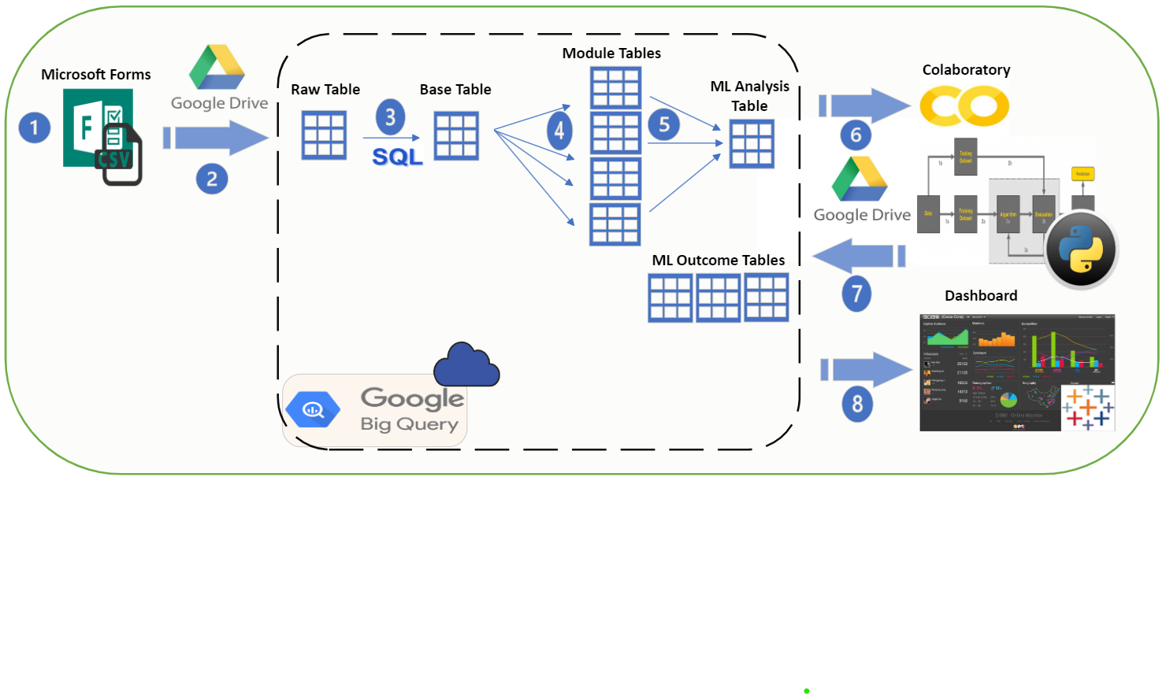
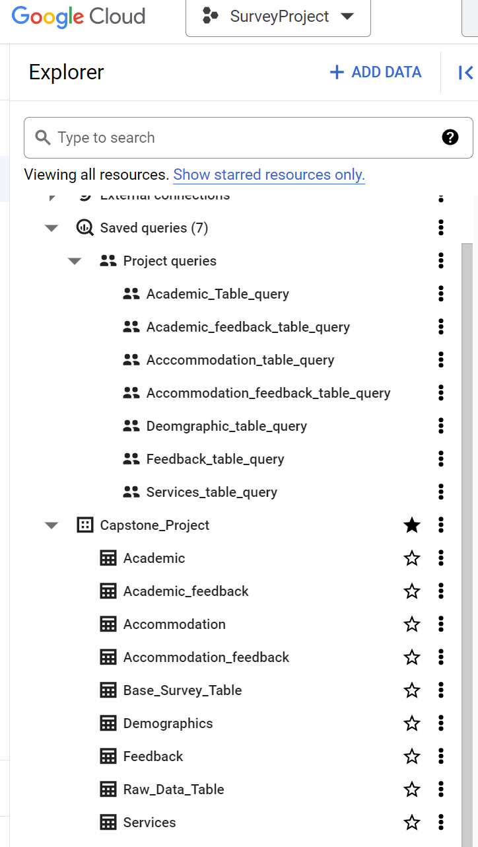








Methodology
Data Intake Phase - Power Automate
Database Ingestion - .CSV to Big Query (through Drive)
Data Movement – DB architecture (inside the Database)
DB to Google Colab (for ML)
Data Stored back to DB
Data to Dashboard (in Tableau)

Slide 11
Challenges and Solutions:
Challenges | Applied Solutions
Data ethics | Used Microsoft Forms to maintain Ethical concerns.
Data Collection | Despite using a primary data source, our efforts to advertise the survey through classes and faculty members enabled us to obtain more than 60% of the intended data.
Data Engineering | Our survey design was intended to be straightforward, but including text field questions has resulted in a data engineering challenge that we are still addressing.
Automation | Our project's data flow has been defined, but we are exploring ways to automate the process for faster results despite the current manual access to active components.
Cloud Pipeline | After thorough research we decided to use Google cloud platform and Big-query
Notes:
The task of controlling and monitoring the progress is assigned to the Campaign manager
Campaign manager is asked to communicate the necessary information based on the RACI matrix and Communication plan to respective parties and stakeholders.
We need to ensure that all related documents such as Project management plan, Schedule , etc., are kept updated according to the change log
Tracks, reviews and regulates the progress and performance of the project and identifies corrective action or changes if needed
Also we Monitor stakeholder Engagement
Monitor & Control Project Work
Perform Integrated Control Change
Validate Scope
- at the end of any major deliverables
- We check for the completeness of the deliverables
for each deliverable this validation performed by PM, Sponsor and related key stakeholders
We do that in each Sprint review (based on our communication doc)
In each sprint review the stakeholders Examine and Test the deliverables
Control Scope
After each Scope Validation, we updated “work performance “ , Then in this step we compare it with our baseline
If any changed is required we handle it through Change management process and creating Change request & after approved or reject we update the Change Log document.
Control Schedule
- Iteration burndown chart , we compare our planned backlog with actual results (as our approach is agile)
Control Costs
By using Data Analysis techniques & Earned Value Analysis
We might need some change request in this part
Control Quality
We use check lists for controlling Quality of any deliverables
Also in test campaign steps we will test the performance & quality of our designed campaign
Control Resource
For example In the running part of the campaign there is some risk that our infrastructure could not handle the load of traffics, so there might be some resource & supply damage. In these situations We will define this problem, find the roots of the problem and choose a suitable solution to solve and check if it solve or not.
As we use Agile approach, part of daily meetings will assign to the barriers and obstacle that team is encounter, so the approach is to solve them as soon as possible and before the end of the sprint with minimum effect to the sprint value.
Monitor Communications
-
Monitor Risks
Identify new risks
We continuedly monitor for emerging risks and change the status of identified risks
Control Procurements
Monitor Stakeholder Engagements

Slide 12
Future Work:
Notes:
These are some of the Final reports that needed to be done in this group:
Main campaign Assessment analytics
Sales report from sales department
Customer care report from customer services
Some examples of Lessons learned in this projects are:
Objectives were clearly defined and quantified
We had Flaws in scheduling that we should learn not to repeat
use of Slack conversation threads was effective int course of the project
For Asset Update:
The time of project staff is freed, and they can return to their day-to-day activities until a new project need arises

Slide 13
Thanks!
Do you have any questions?

